Slide 1


Spark Interview Questions Spark Internals Part-2

Slide 2
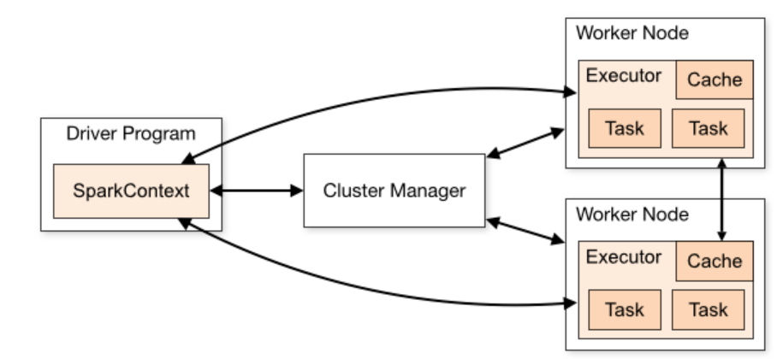
Spark Architecture

Slide 3
Further Deep dive in this Part-2

Slide 4
Program Code(Jar) and configuration
Worker Node
Executor
Task
Task
spark=SparkSession.builder…..
spark.sparkContext
rdd =spark.read.t
rdd.filter()
rdd.map()
rdd.count()→Action
Driver
Allocated the resources.
Track submitted job/tasks
Cluster Manager
Request for the Worker/ Executors in the cluster
Worker Node
Executor
Task
Task
Spark Context
Once the Action is called, Job is created
DAG Scheduler
Task Scheduler
RDD1
RDD2
Task
Worker Node
TASKS
Executor
Task
Task
Task
JOB
RDD
Task
RDD
Task
Launch task via cluster manager
DAG is created and split into stages of tasks and submitted to Task Scheduler as ready
Program Code(Jar) and configuration

Slide 5
Detailed Execution flow
Using spark-submit, the spark application job is initiated.
First thing driver program is launched, which invokes the main() method that the user specifies in the Jar.
The driver program asks for the resources to the cluster manager those are needed to launch executors.
The cluster manager launches executors on behalf of the driver program.
The driver process runs as per the processing program.
Based on the transformations-DAG is created with the help of DAGScheduler and once action is encountered JOB is created, JOB is the collection of stages of tasks, post that the driver sends work to executors in the form of tasks with the help Of TaskScheduler via cluster manager.
The executors process the task and the result sends back to the driver through the cluster manager.

Slide 6
Program Code(Jar) and configuration
Worker Node
Executor
Task
Task
spark=SparkSession.builder…..
spark.sparkContext
rdd =spark.read.t
rdd.filter()
rdd.map()
rdd.count()→Action
Driver
Allocated the resources.
Track submitted job/tasks
Cluster Manager
Request for the Worker/ Executors in the cluster
Worker Node
Executor
Task
Task
Spark Context
Once the Action is called, Job is created
DAG Scheduler
Task Scheduler
RDD1
RDD2
Task
Worker Node
TASKS
Executor
Task
Task
Task
JOB
RDD
Task
RDD
Task
Launch task via cluster manager
DAG is created and split into stages of tasks and submitted to Task Scheduler as ready
Program Code(Jar) and configuration

Slide 7
Thanks and do subscribe to my channel

